Slide 1
Chapter 5
Reduction of Multiple Subsystems

Slide 2
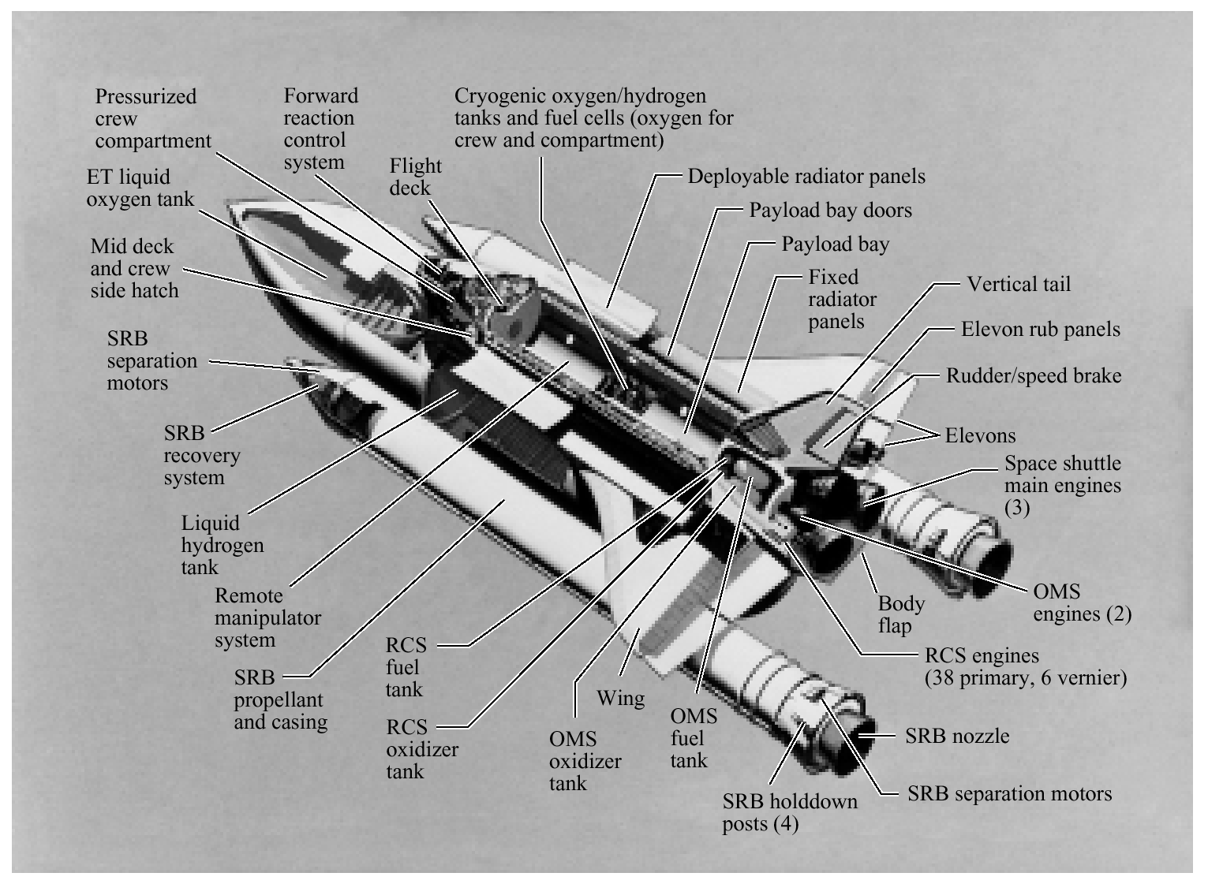
Figure 5.1
The space shuttle
consists of multiple
subsystems. Can you
identify those that
are control systems,
or parts of control
systems?

Slide 3
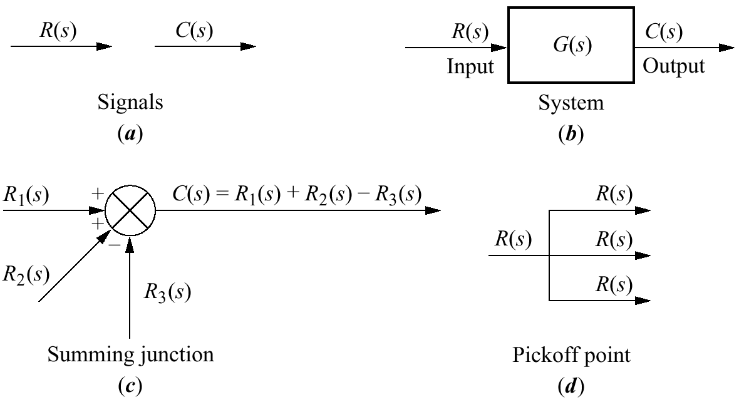
Figure 5.2
Components of a
block diagram for a
linear, time-invariant
system

Slide 4
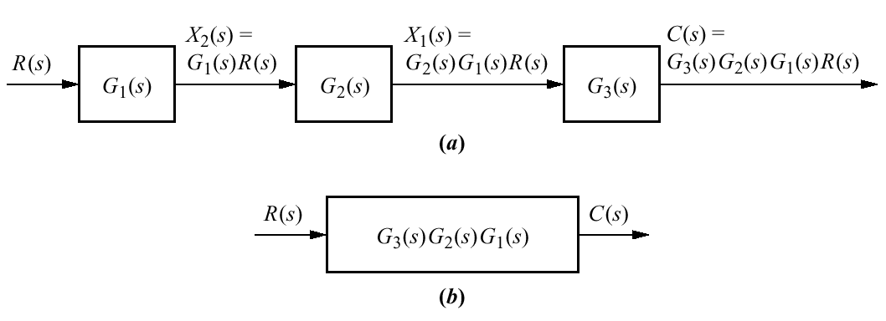
Figure 5.3
a. Cascaded
subsystems;
b. equivalent transfer
function

Slide 5
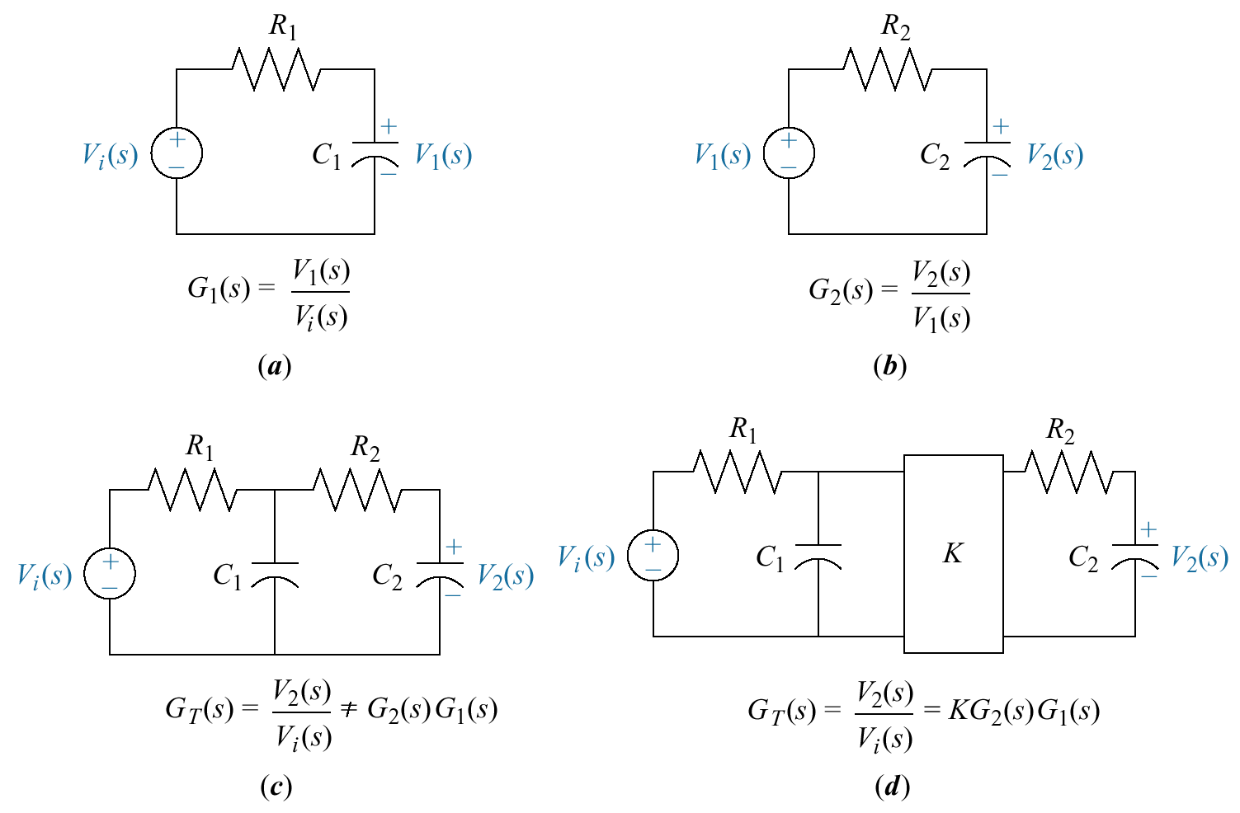
Figure 5.4
Loading in cascaded
systems

Slide 6
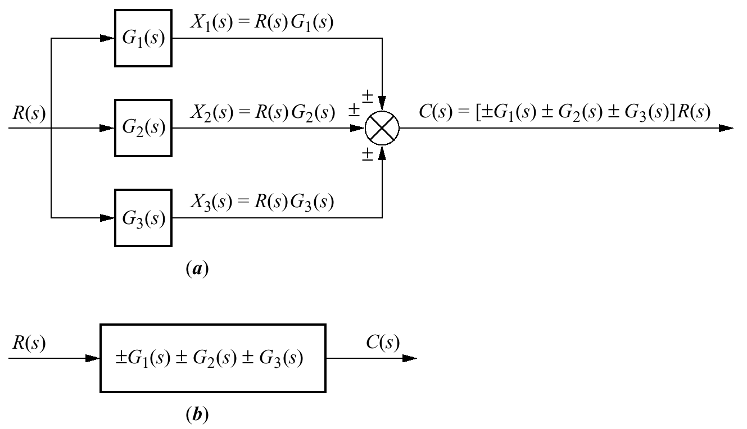
Figure 5.5
a. Parallel
subsystems;
b. equivalent
transfer
function

Slide 7
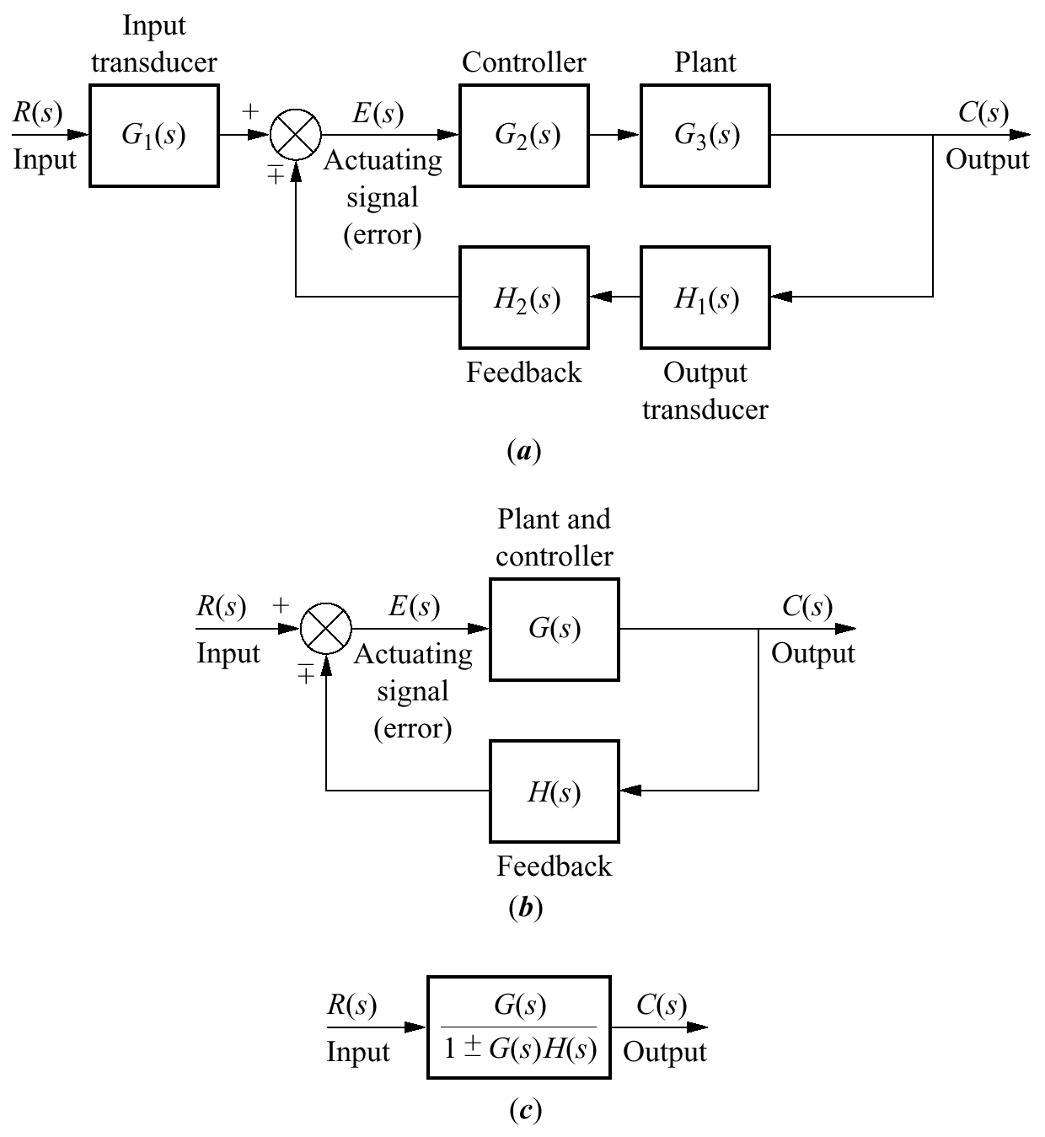
Figure 5.6
a. Feedback control
system;
b. simplified model;
c. equivalent transfer
function

Slide 8
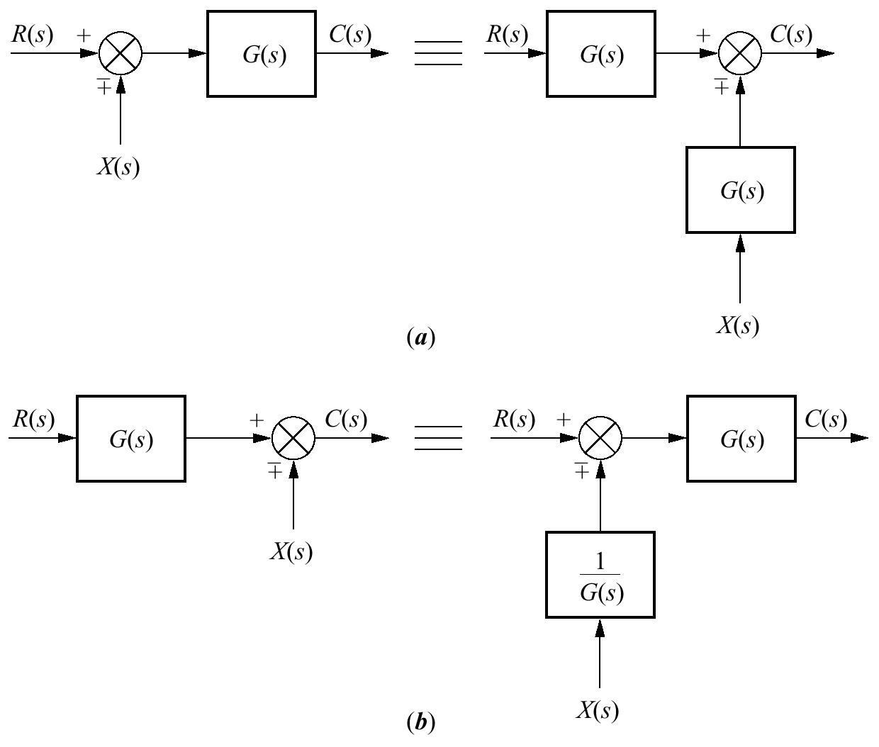
Figure 5.7
Block diagram
algebra for summing
junctions—equivalent
forms for moving a
block
a. to the left past a
summing junction;
b. to the right past a
summing junction

Slide 9
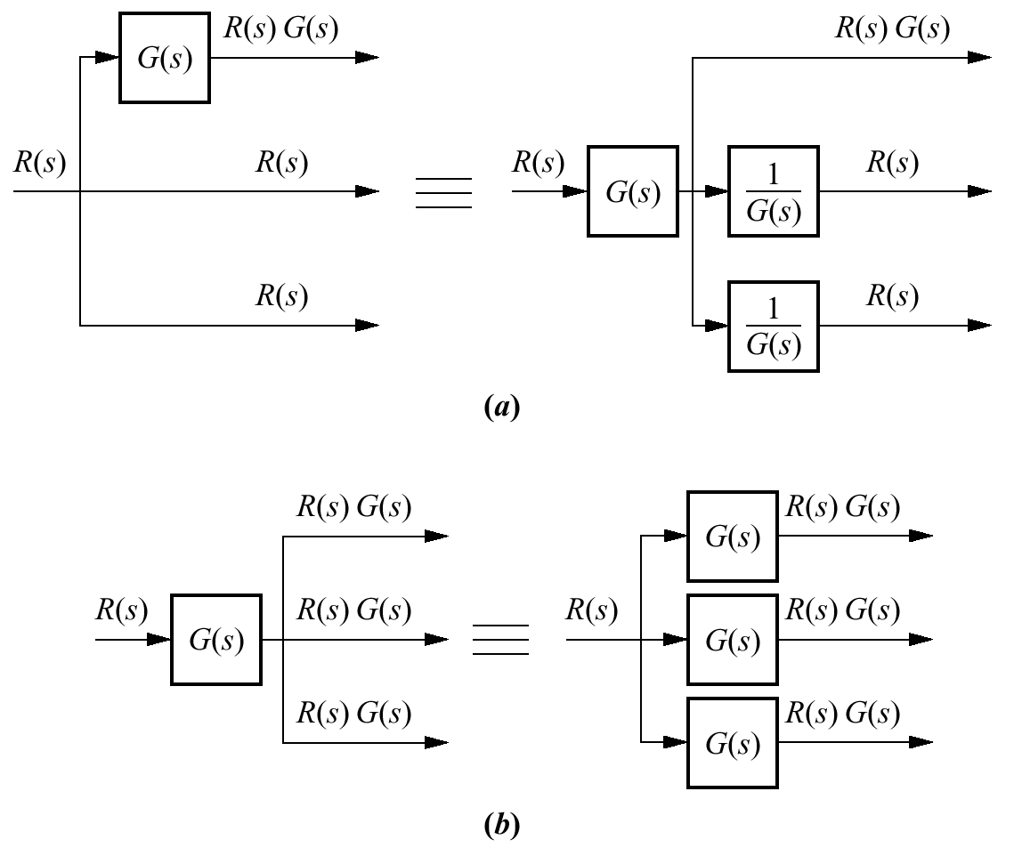
Figure 5.8
Block diagram algebra
for pickoff points—
equivalent forms for
moving a block
a. to the left past a
pickoff point;
b. to the right past a
pickoff point

Slide 10
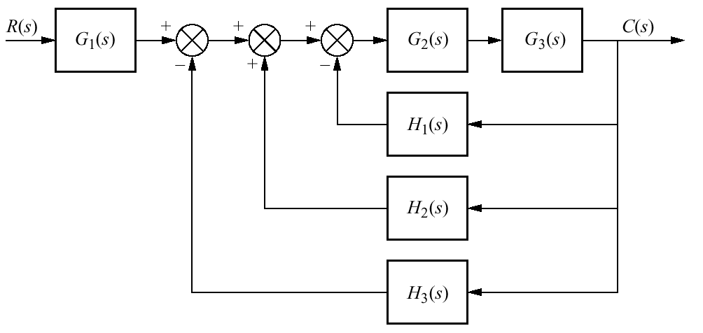
Figure 5.9
Block diagram
for Example5.1

Slide 11
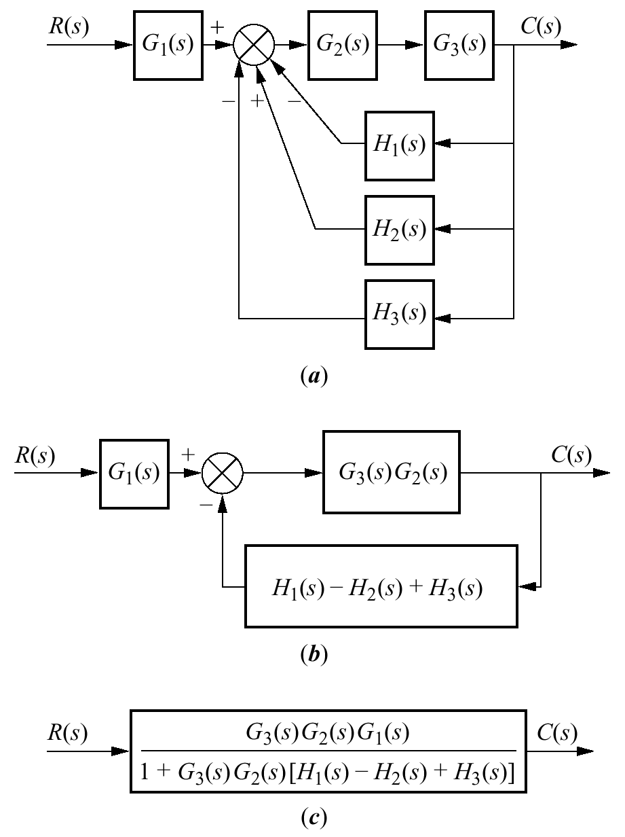
Figure 5.10
Steps in solving
Example 5.1:
a. collapse summing
junctions;
b. form equivalent
cascaded system
in the forward path
and equivalent
parallel system in the
feedback path;
c. form equivalent
feedback system and
multiply by cascaded
G₁(s)

Slide 12
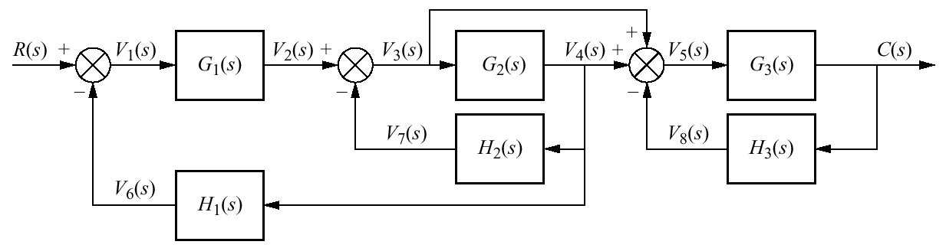
Figure 5.11
Block diagram for
Example 5.2

Slide 13
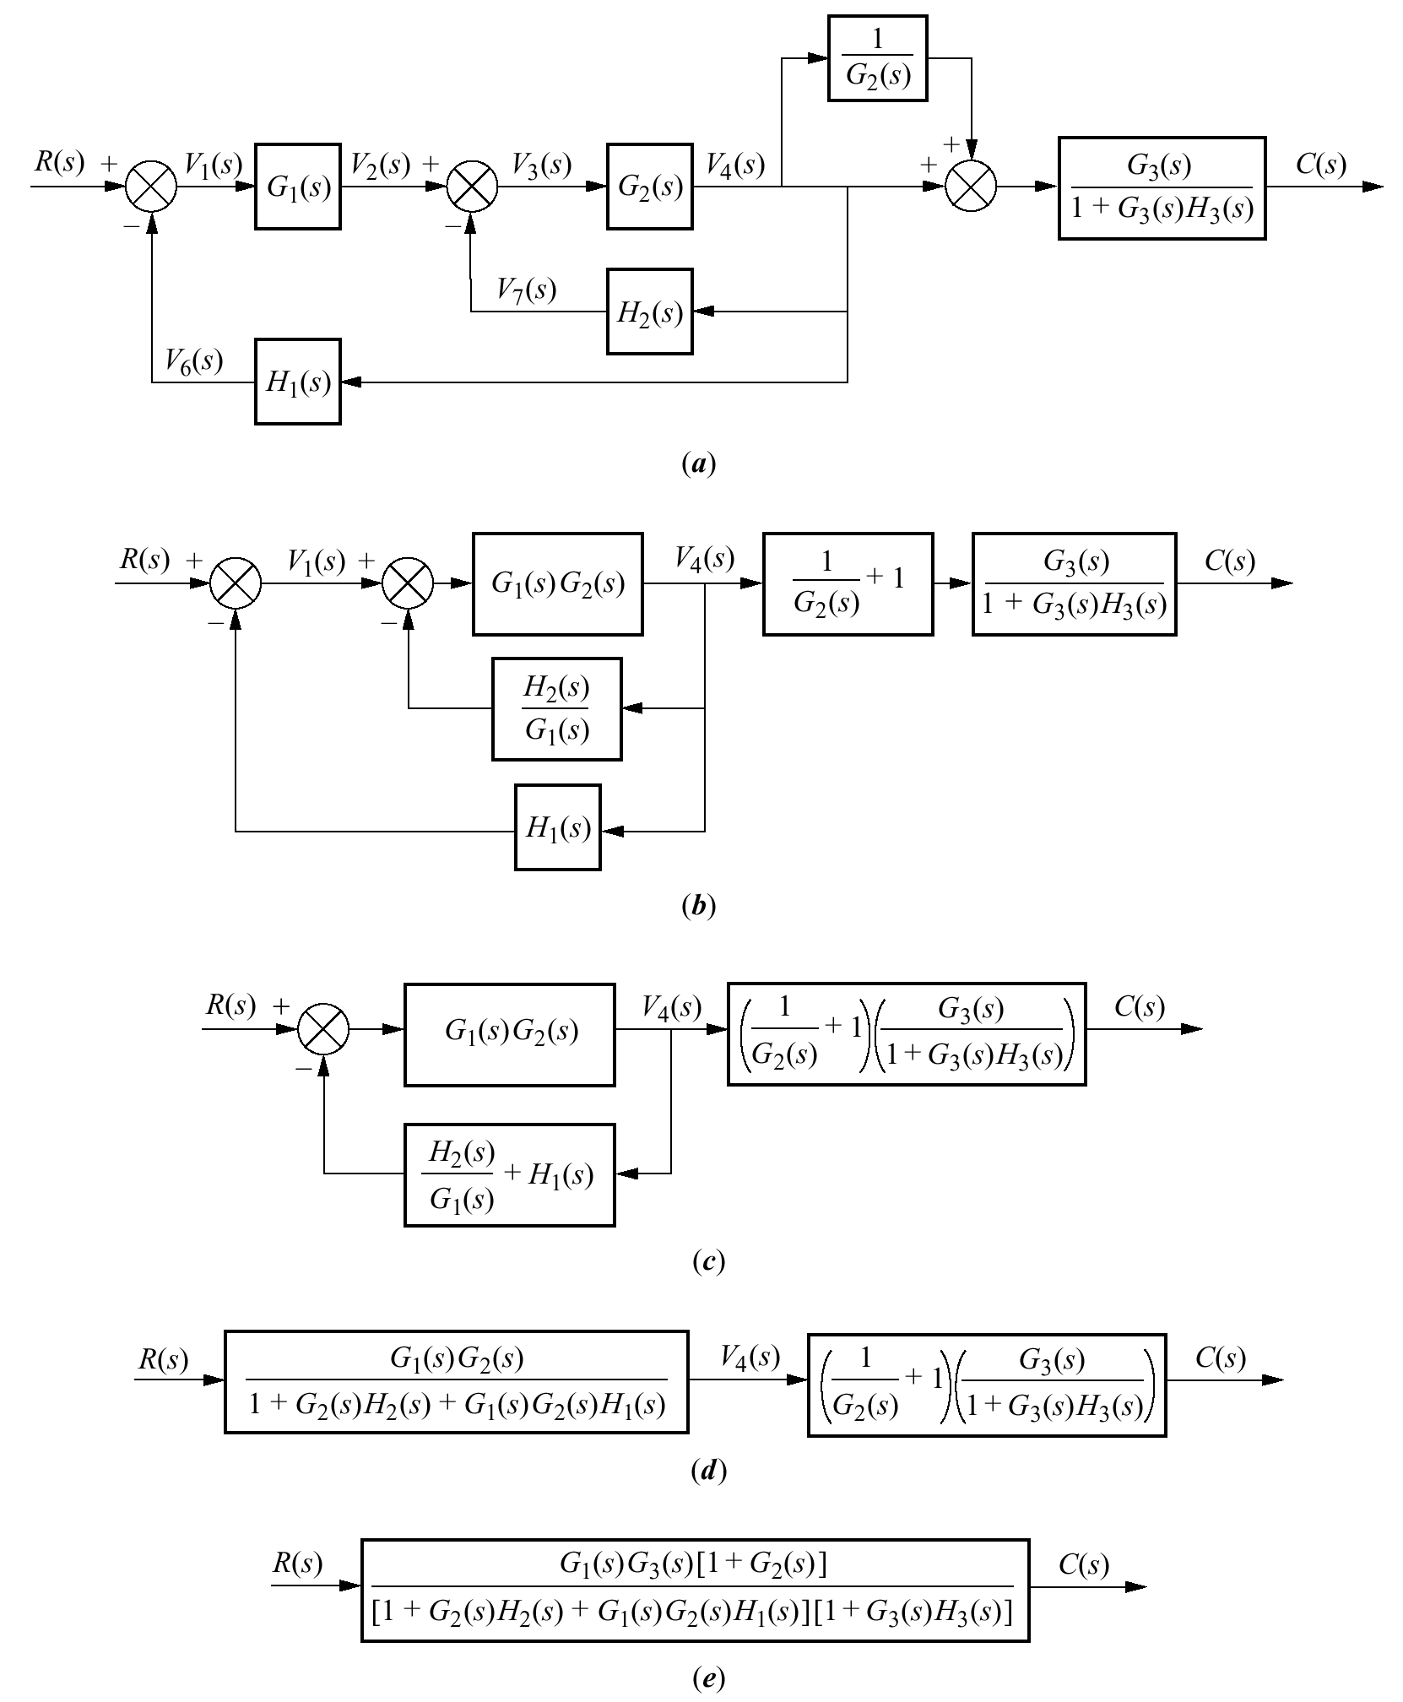
Figure 5.12
Steps in the
block diagram
reduction for
Example 5.2

Slide 14
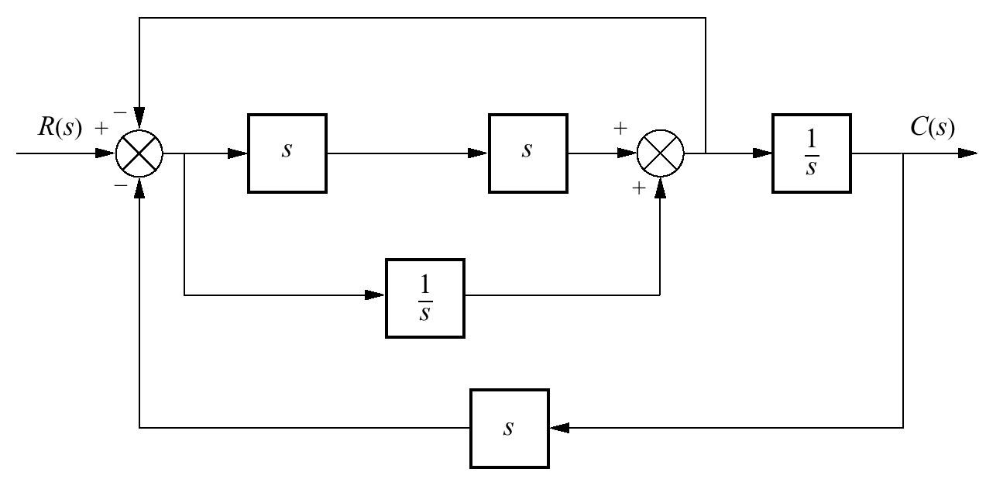
Figure 5.13
Block diagram for
Skill-Assessment
Exercise 5.1

Slide 15
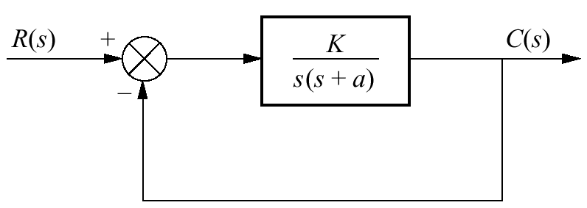
Figure 5.14
Second-order
feedback control
system

Slide 16
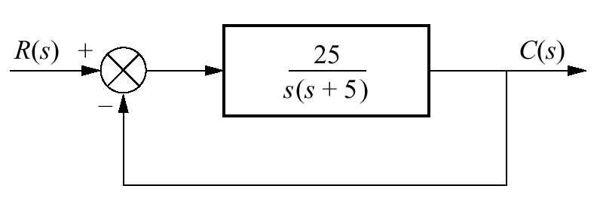
Figure 5.15
Feedback system for
Example 5.3

Slide 17
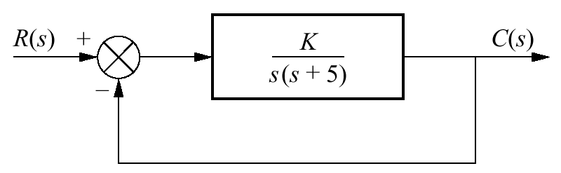
Figure 5.16
Feedback system for
Example 5.4

Slide 18
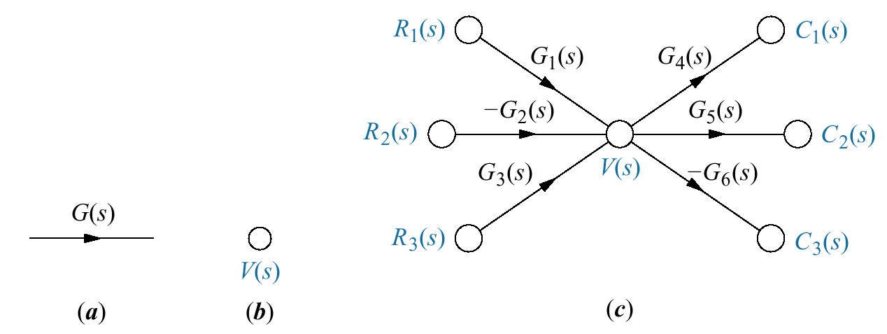
Figure 5.17
Signal-flow graph
components:
a. system;
b. signal;
c. interconnection of
systems and signals

Slide 19
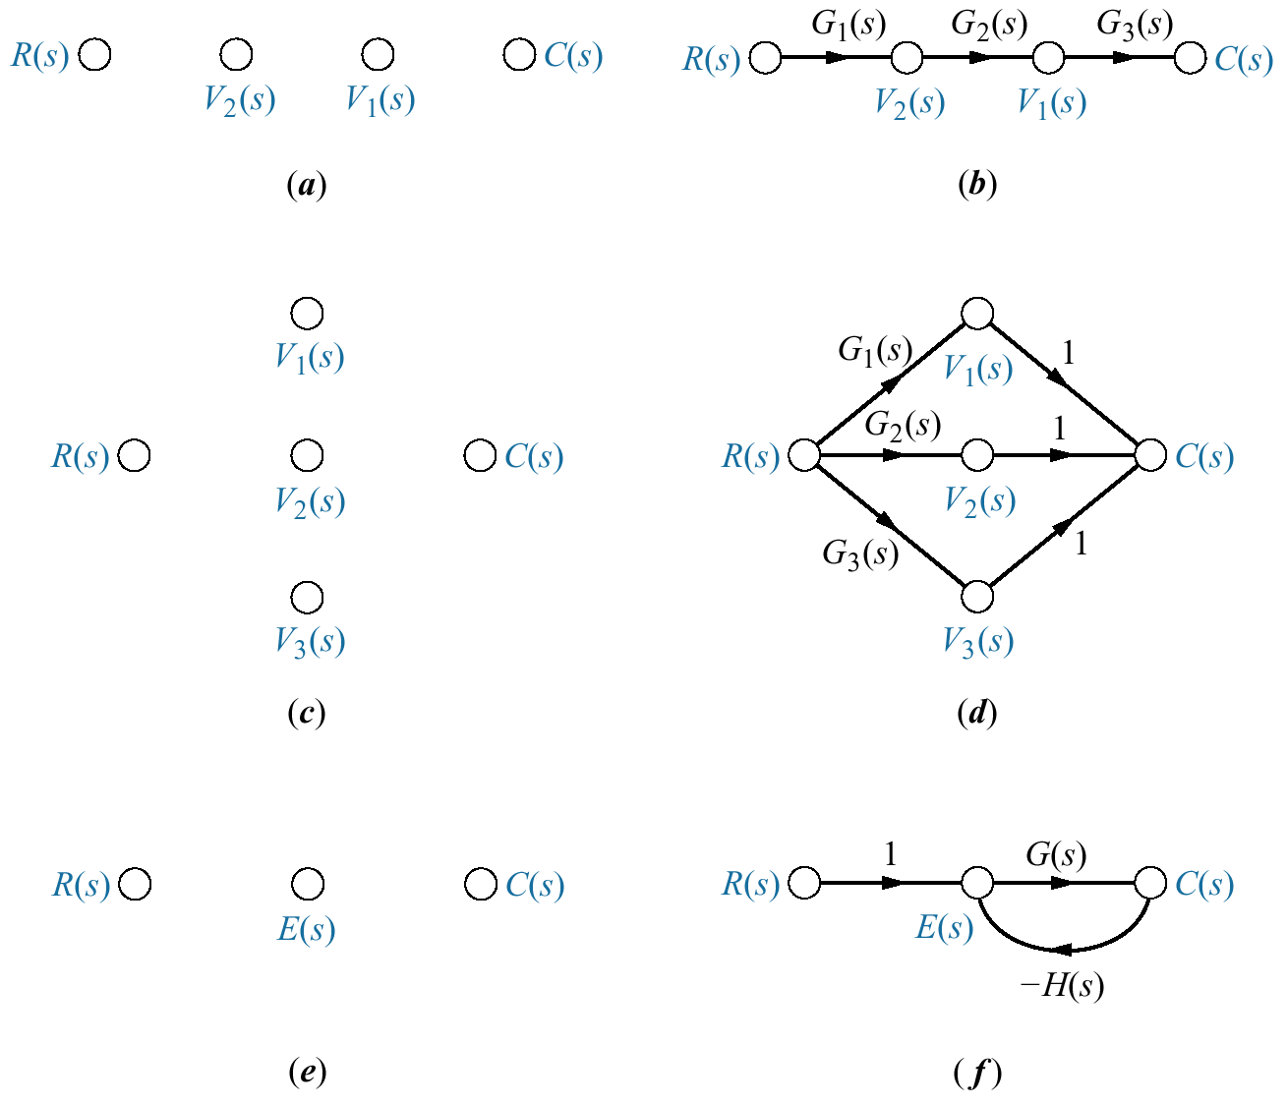
Figure 5.18
Building signal-flow
graphs:
a. cascaded system
nodes (from Figure
5.3(a));
b. cascaded system
signal-flow graph;
c. parallel system
nodes (from Figure
5.5(a));
d. parallel system
signal-flow graph;
e. feedback system
nodes (from Figure
5.6(b));
f. feedback system
signal-flow graph

Slide 20
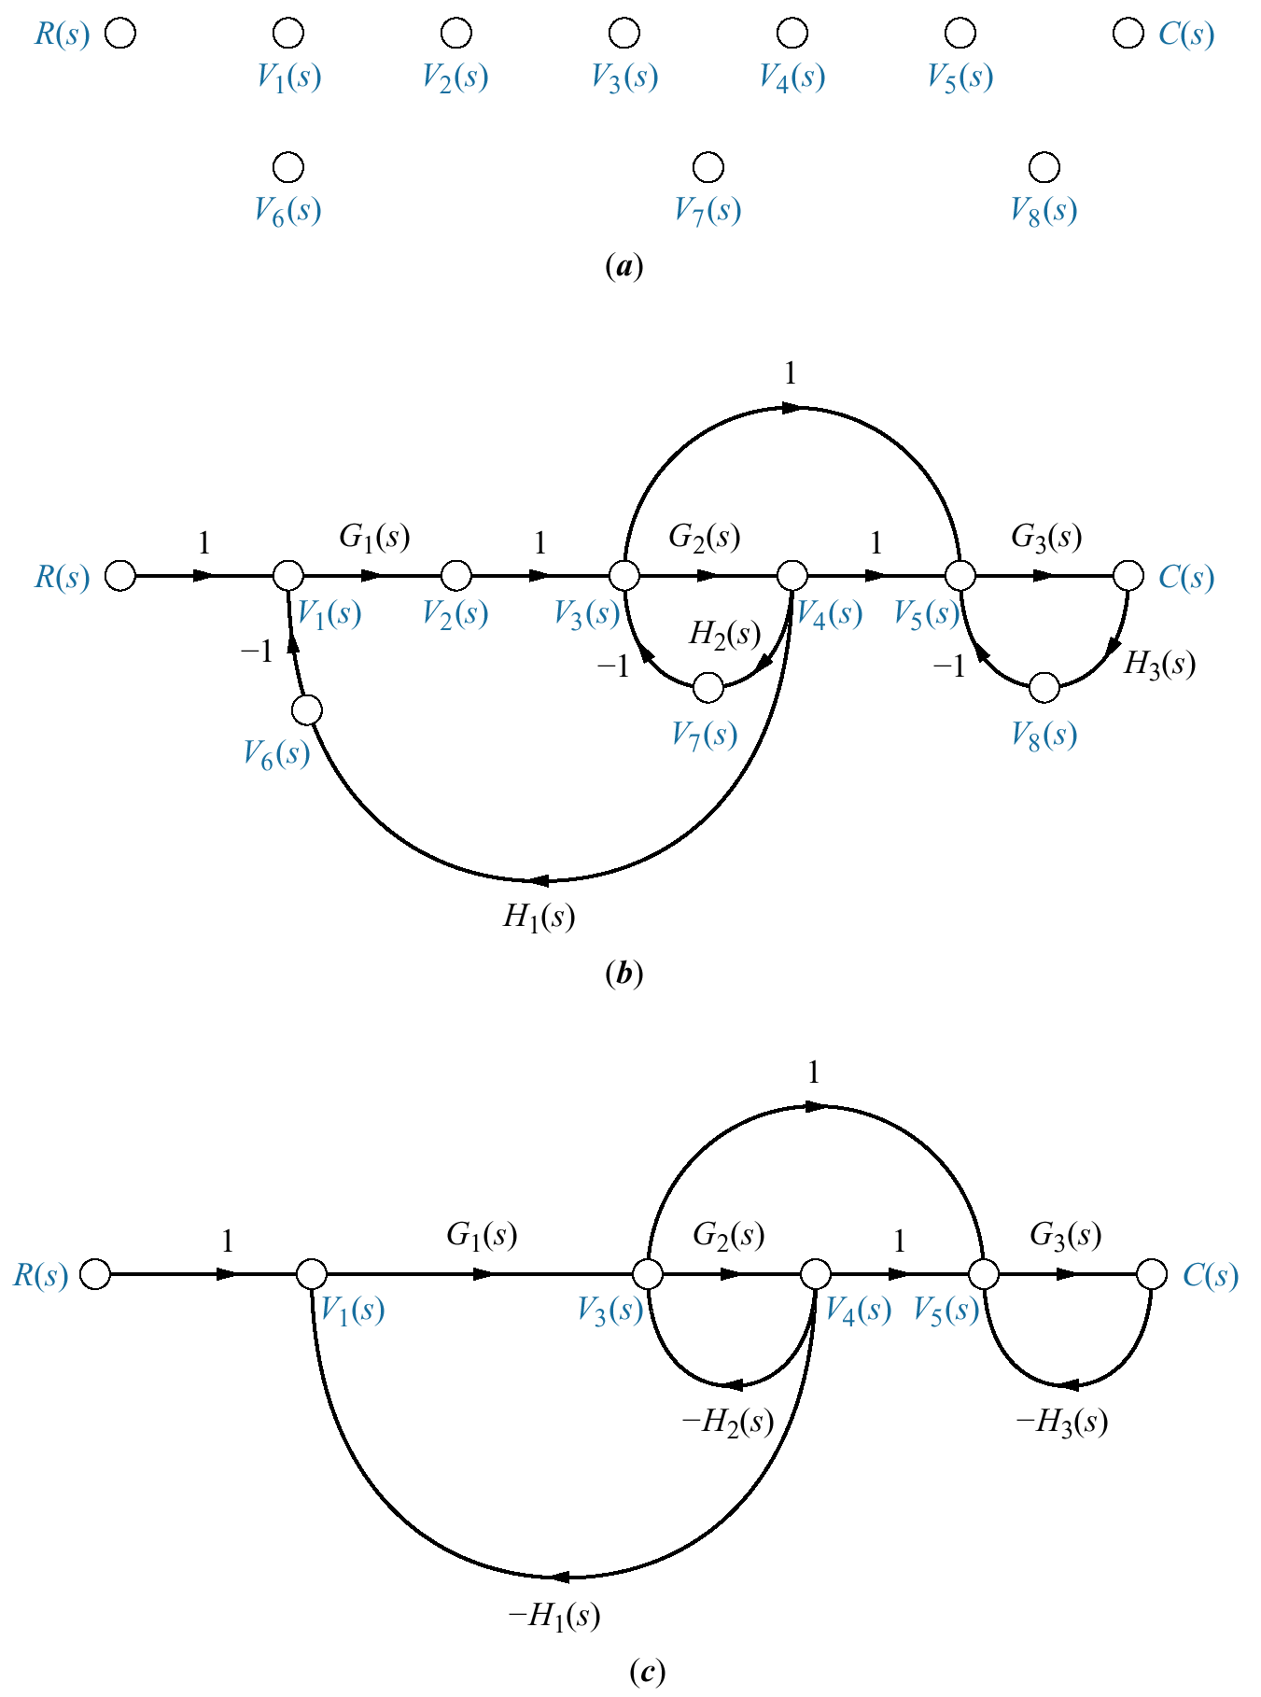
Figure 5.19
Signal-flow graph
development:
a. signal nodes;
b. signal-flow graph;
c. simplified signal-
flow graph

Slide 21
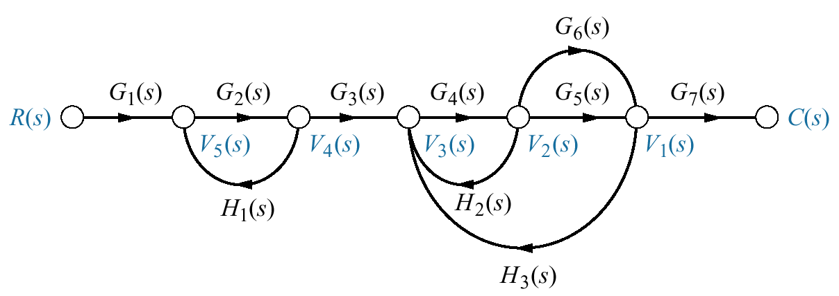
Figure 5.20
Signal-flow graph
for demonstrating
Mason’s rule

Slide 22
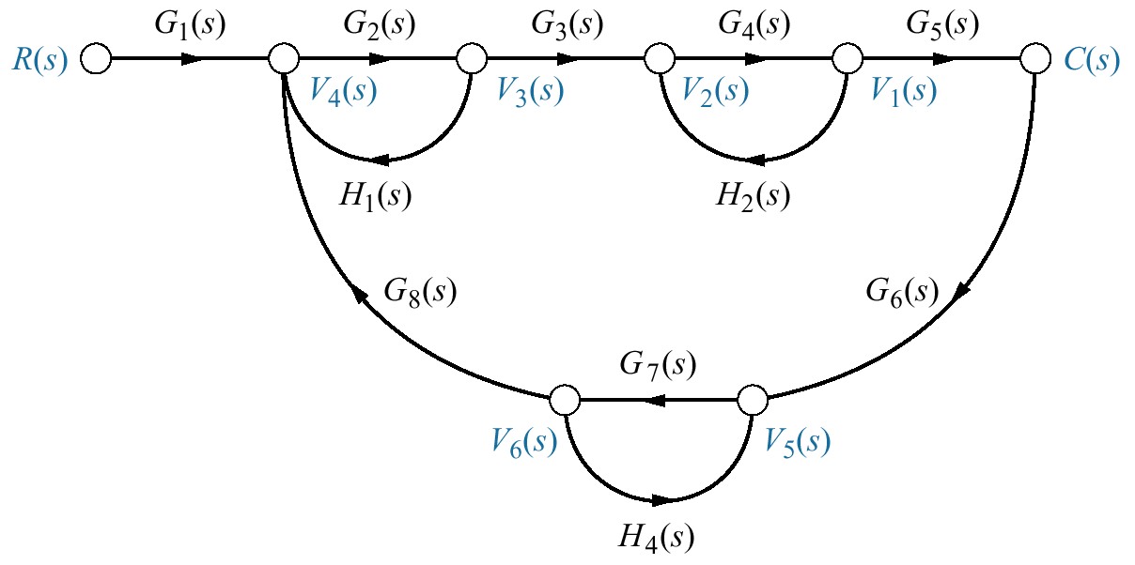
Figure 5.21
Signal-flow graph for
Example 5.7

Slide 23
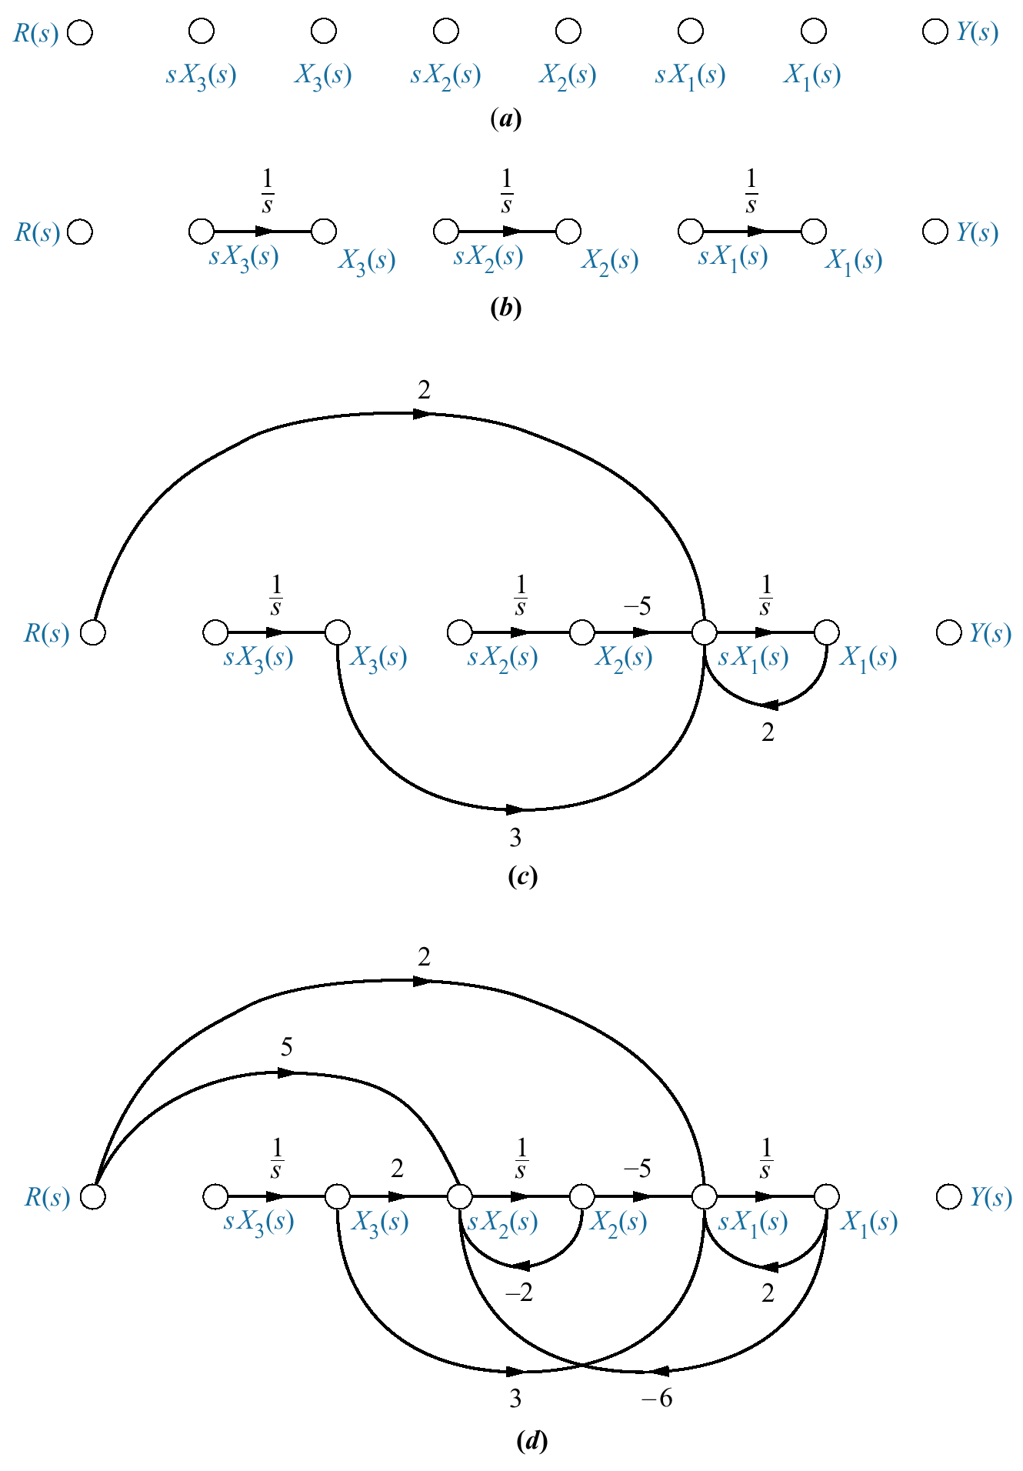
Figure 5.22
Stages of
development of a
signal-flow graph
for the system of
Eqs. 5.36:
a. place nodes;
b. interconnect
state variables and
derivatives;
c. form dx₁/dt ;
d. form dx₂/dt
(figure continues)

Slide 24
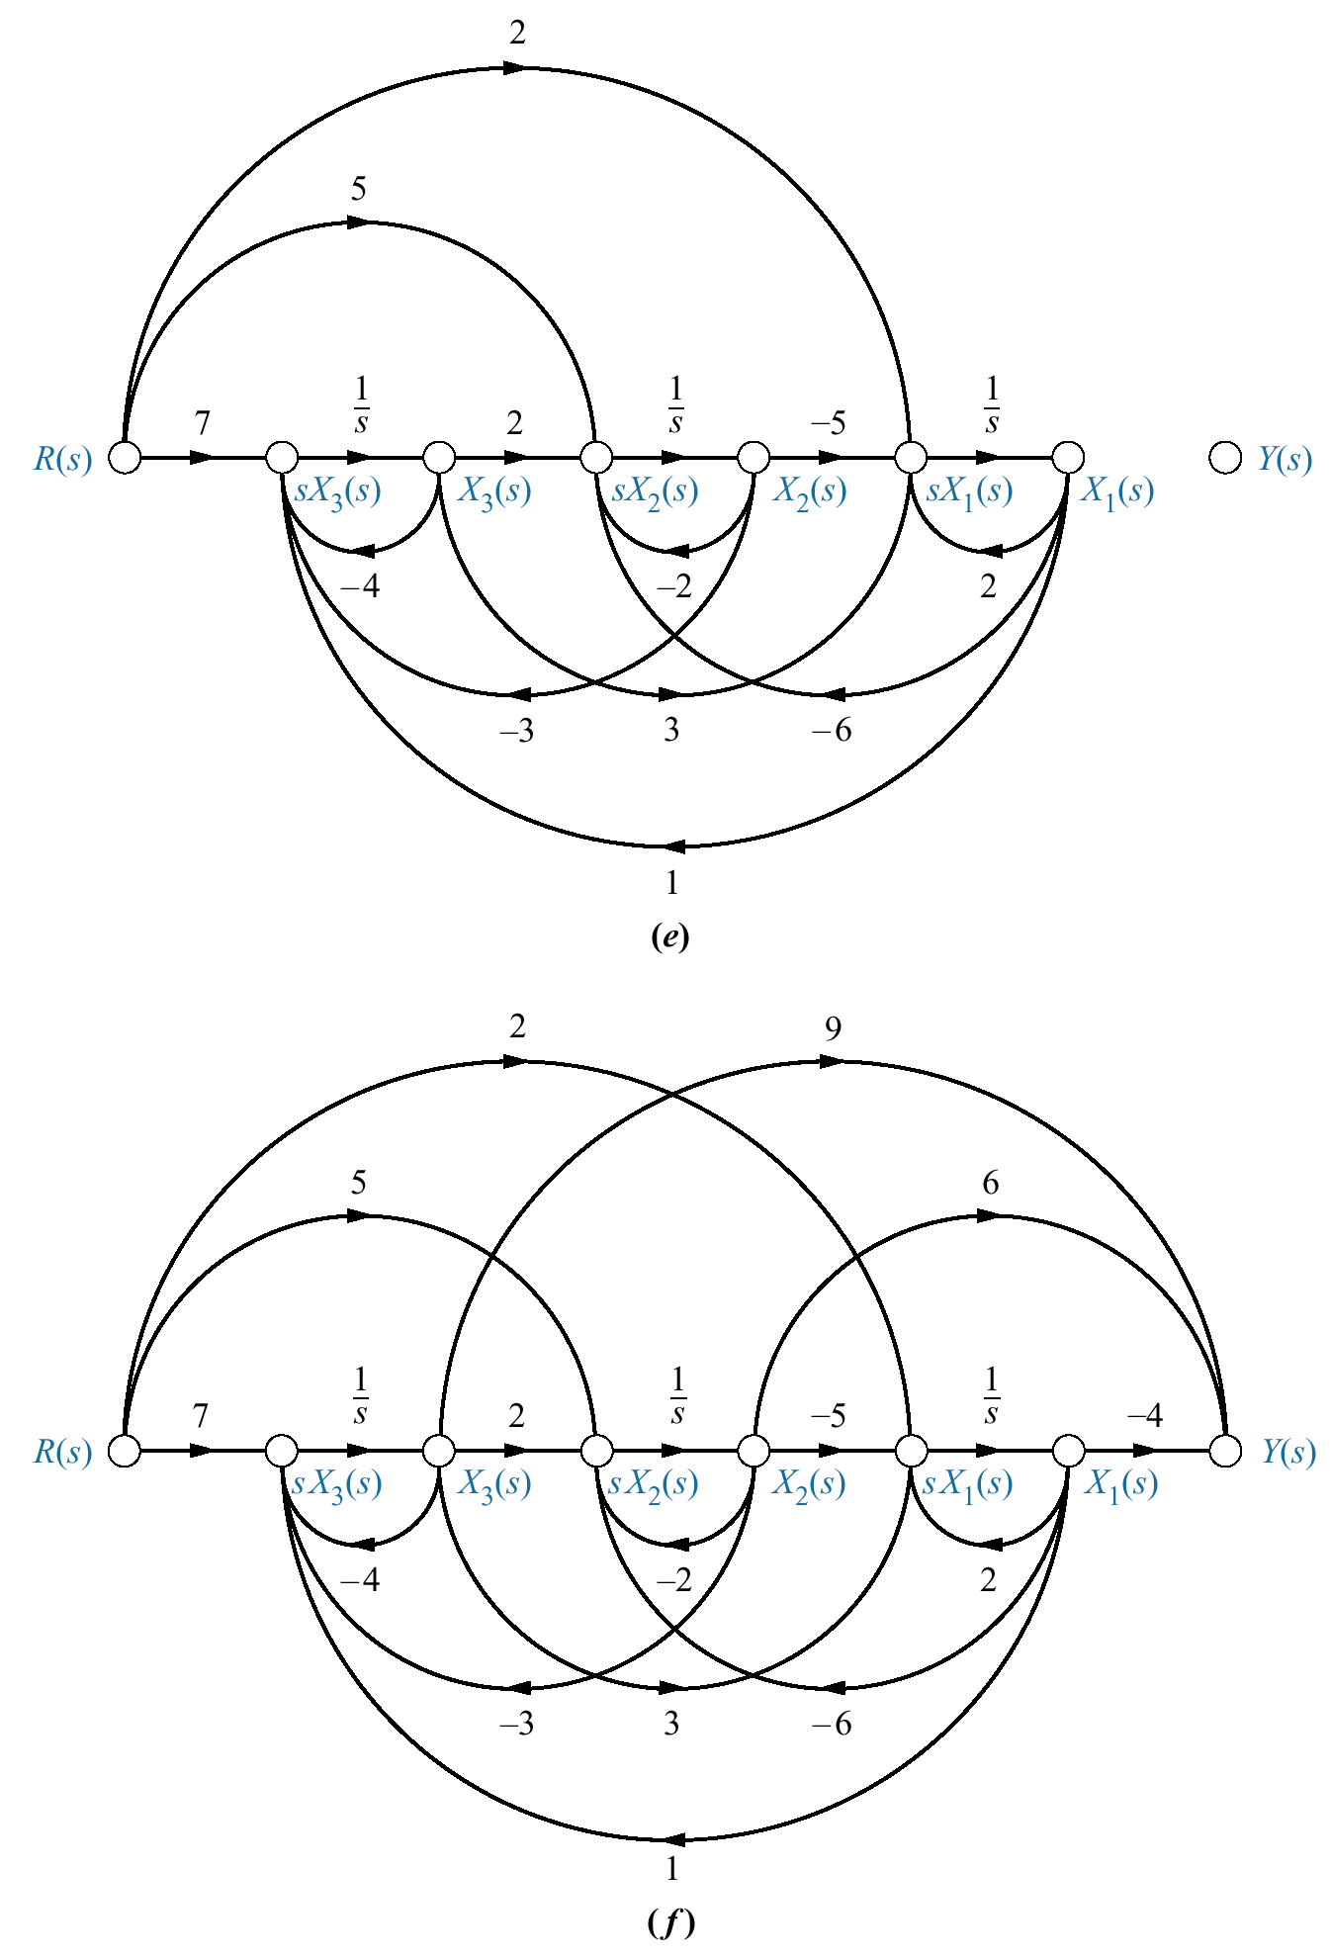
Figure 5.22
(continued)
e. form dx₃/dt;
f. form output

Slide 25
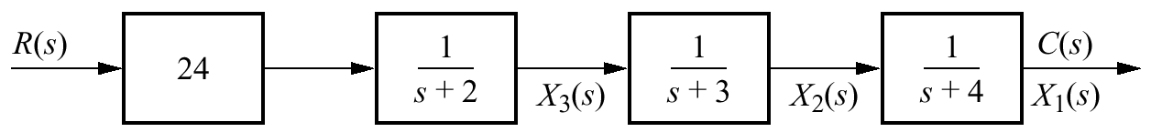
Figure 5.23
Representation of
Figure 3.10 system as
cascaded first-order
systems

Slide 26
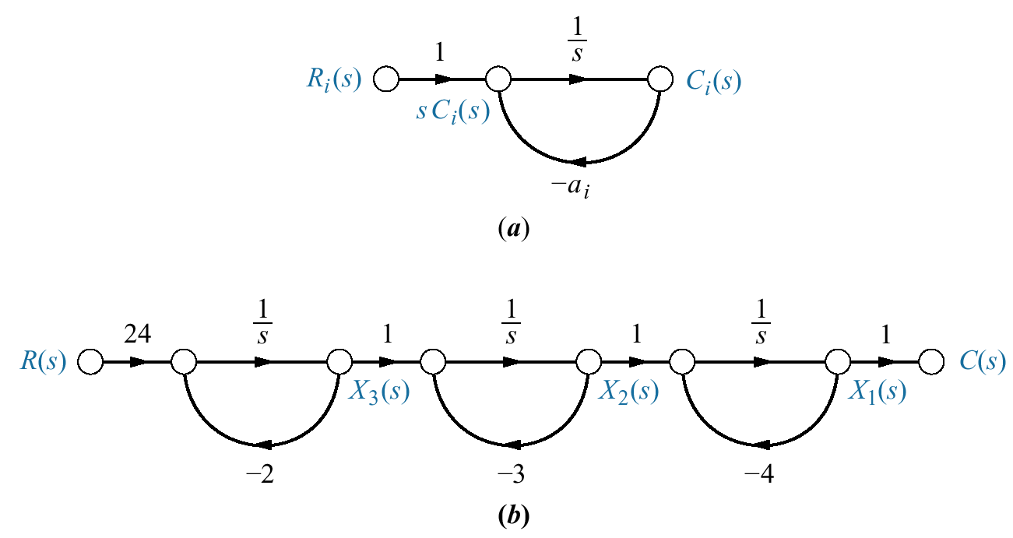
Figure 5.24
a. First-order
subsystem;
b. signal-flow graph
for Figure 5.23
system

Slide 27
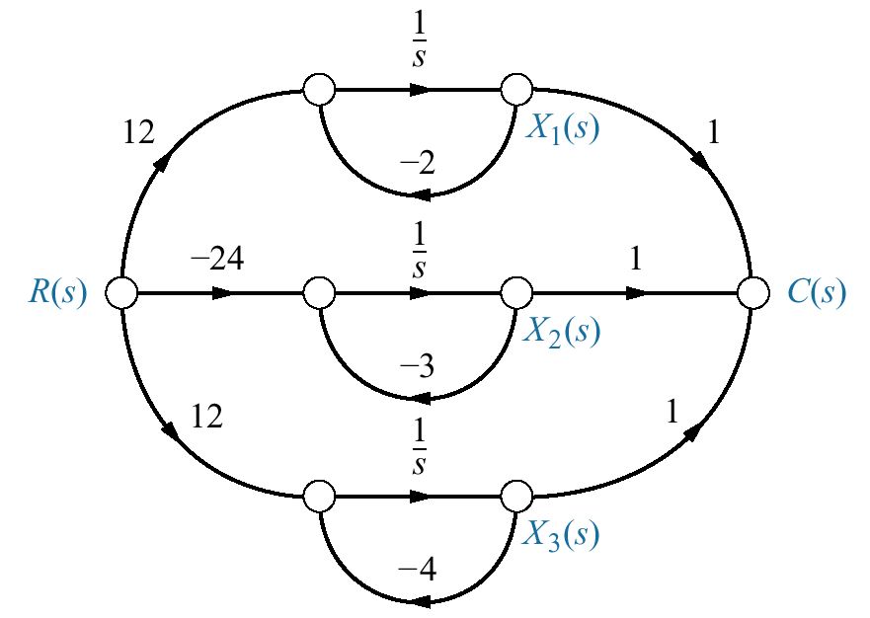
Figure 5.25
Signal-flow
representation
of Eq. (5.45)

Slide 28
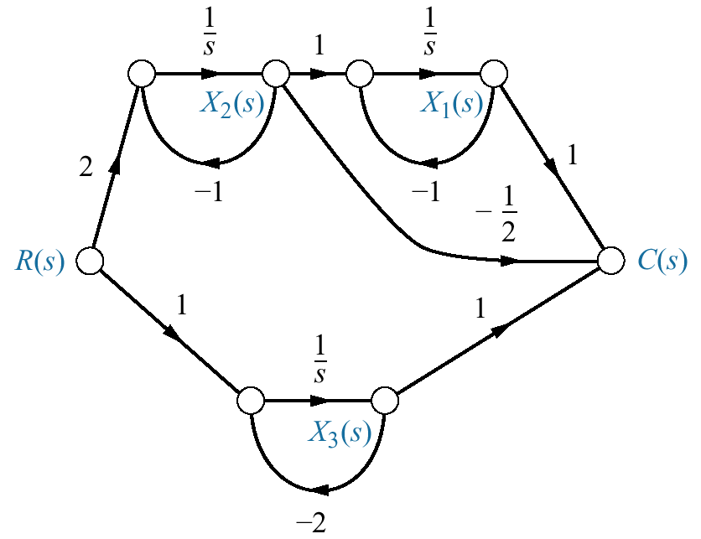
Figure 5.26
Signal-flow
representation
of Eq. (5.52)

Slide 29
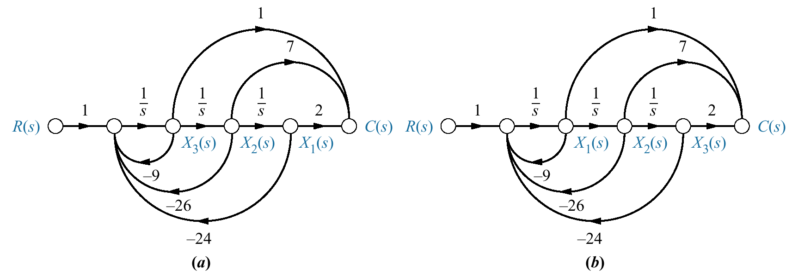
Figure 5.27
Signal-flow graphs for
obtaining forms for
G(s) = C(s)/R(s) =
(s² + 7s + 2)/(s³ +
9s² + 26s + 24):
a. phase-variable form;
b. controller canonical form

Slide 30
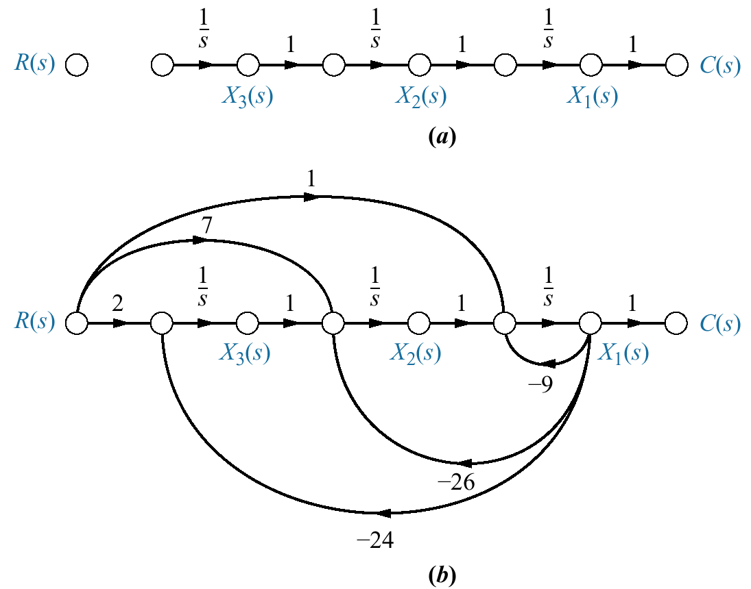
Figure 5.28
Signal-flow graph for
observer canonical
form variables:
a. planning;
b. implementation

Slide 31
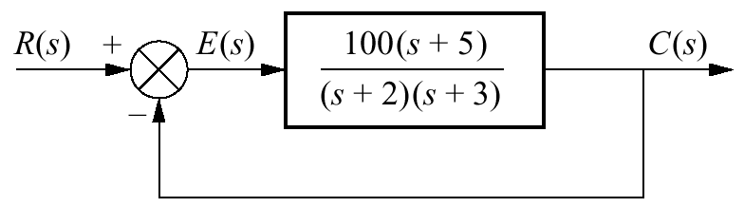
Figure 5.29
Feedback
control system
for Example 5.8

Slide 32
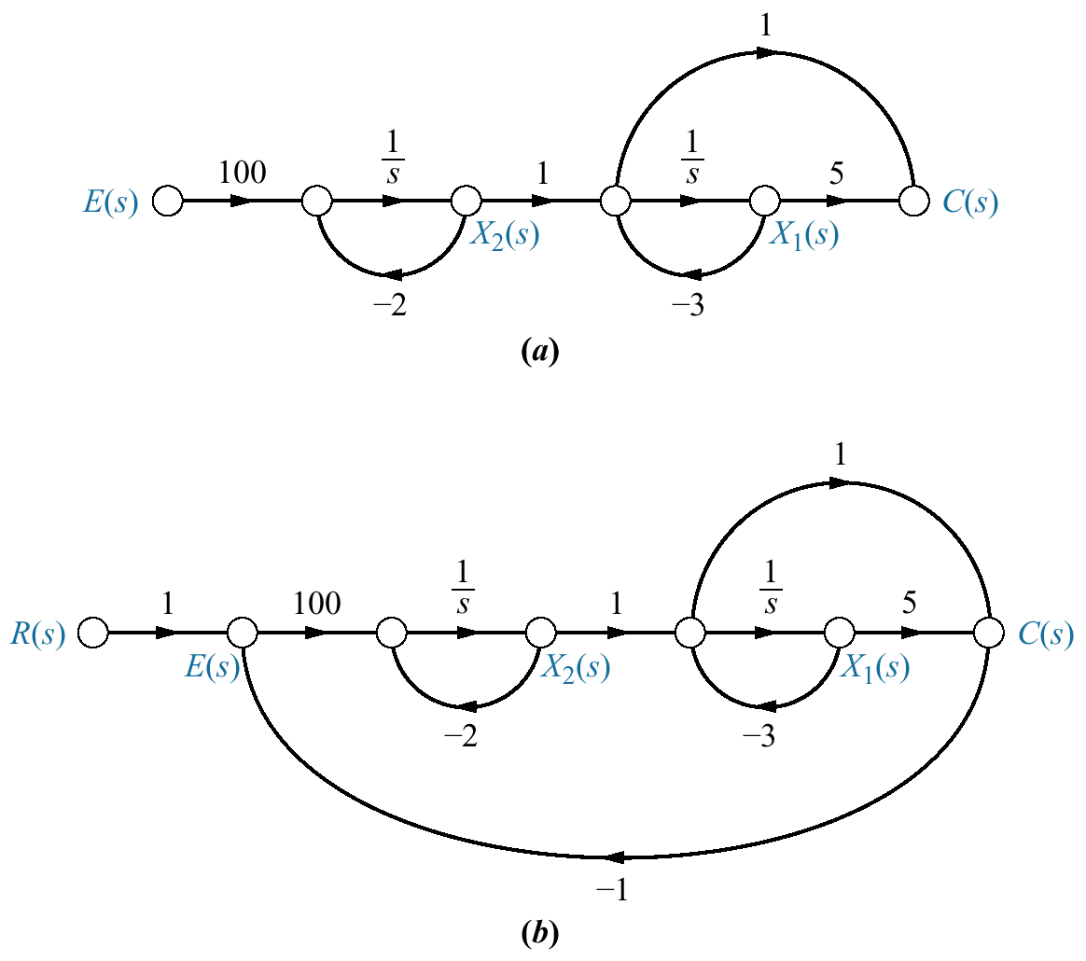
Figure 5.30
Creating a signal-flow
graph for the
Figure 5.29 system:
a. forward transfer
function;
b. complete system

Slide 33
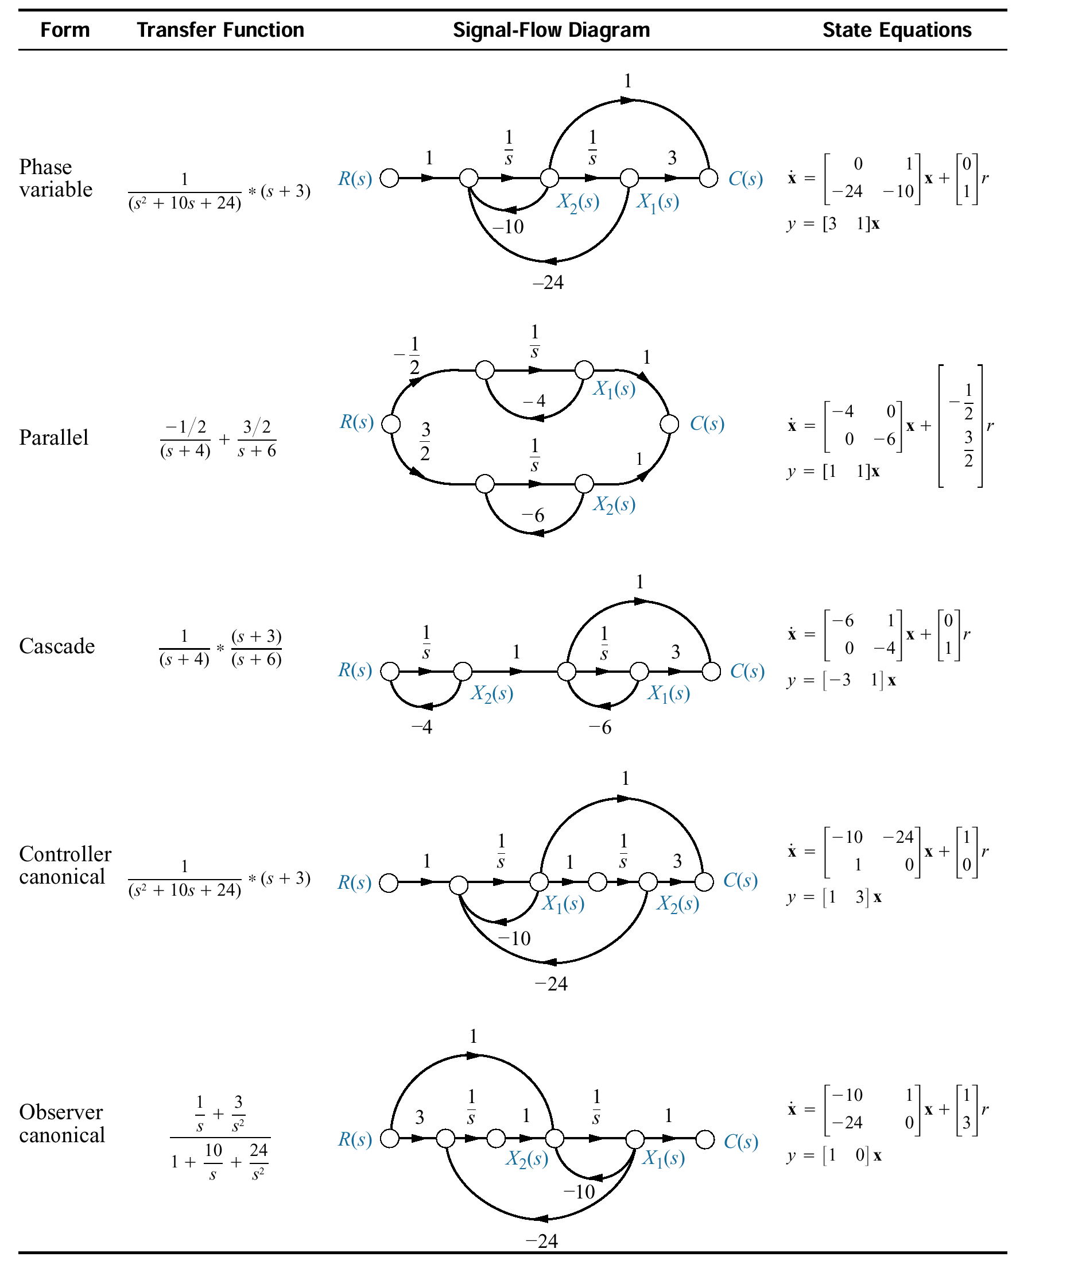
Figure 5.31
State-space forms for
C(s)/R(s) =
(s+ 3)/[(s+ 4)(s+ 6)].
Note: y = c(t)

Slide 34
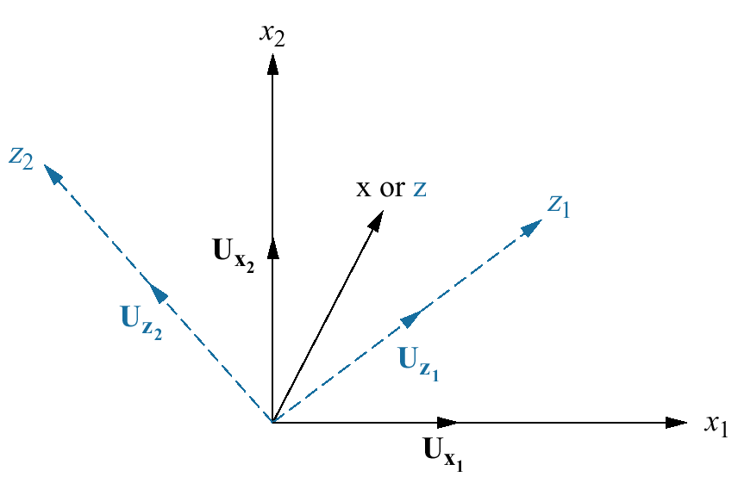
Figure 5.32
State-space
transformations

Slide 35
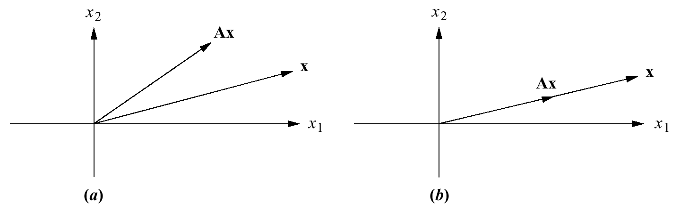
Figure 5.33
To be an eigenvector,
the transformation Ax
must be collinear with
x; thus in (a) x is not
an eigenvector; in (b),
it is.

Slide 36
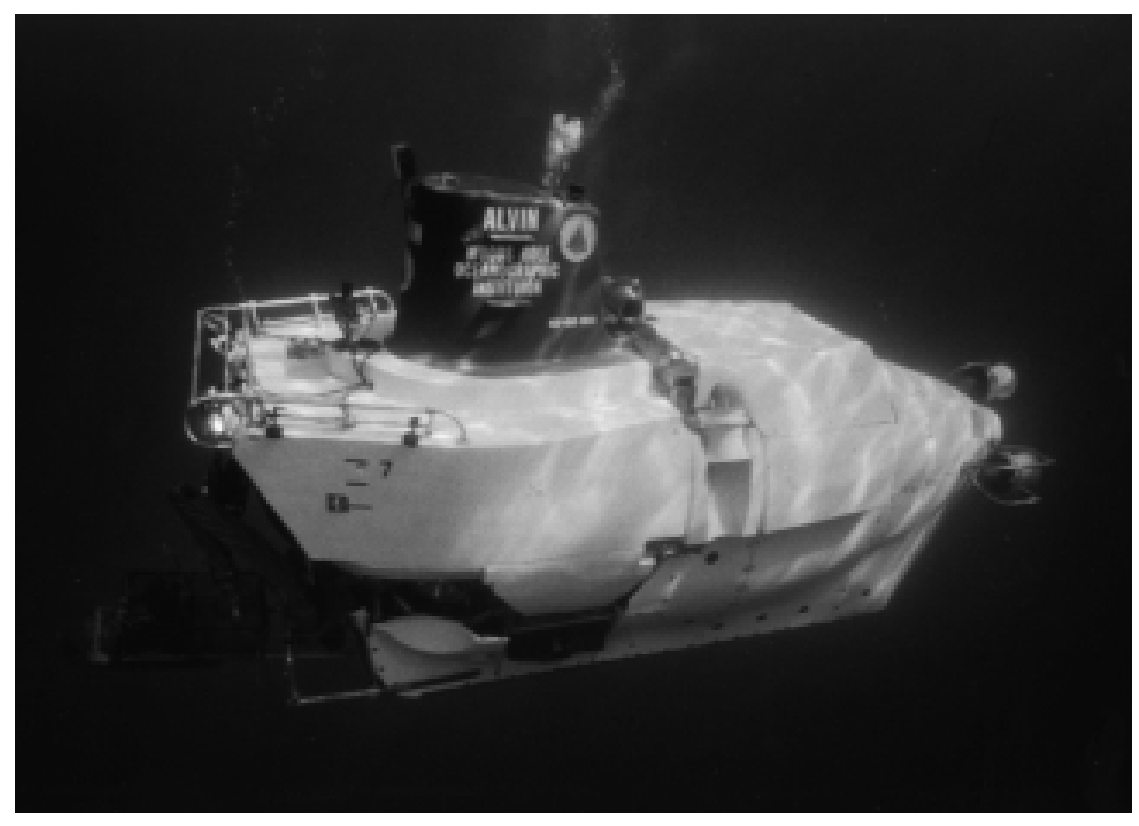
Figure 5.34
Alvin, a manned
submersible,
explored the
wreckage of the
Titanic with a
tethered robot,
Jason Junior.

Slide 37
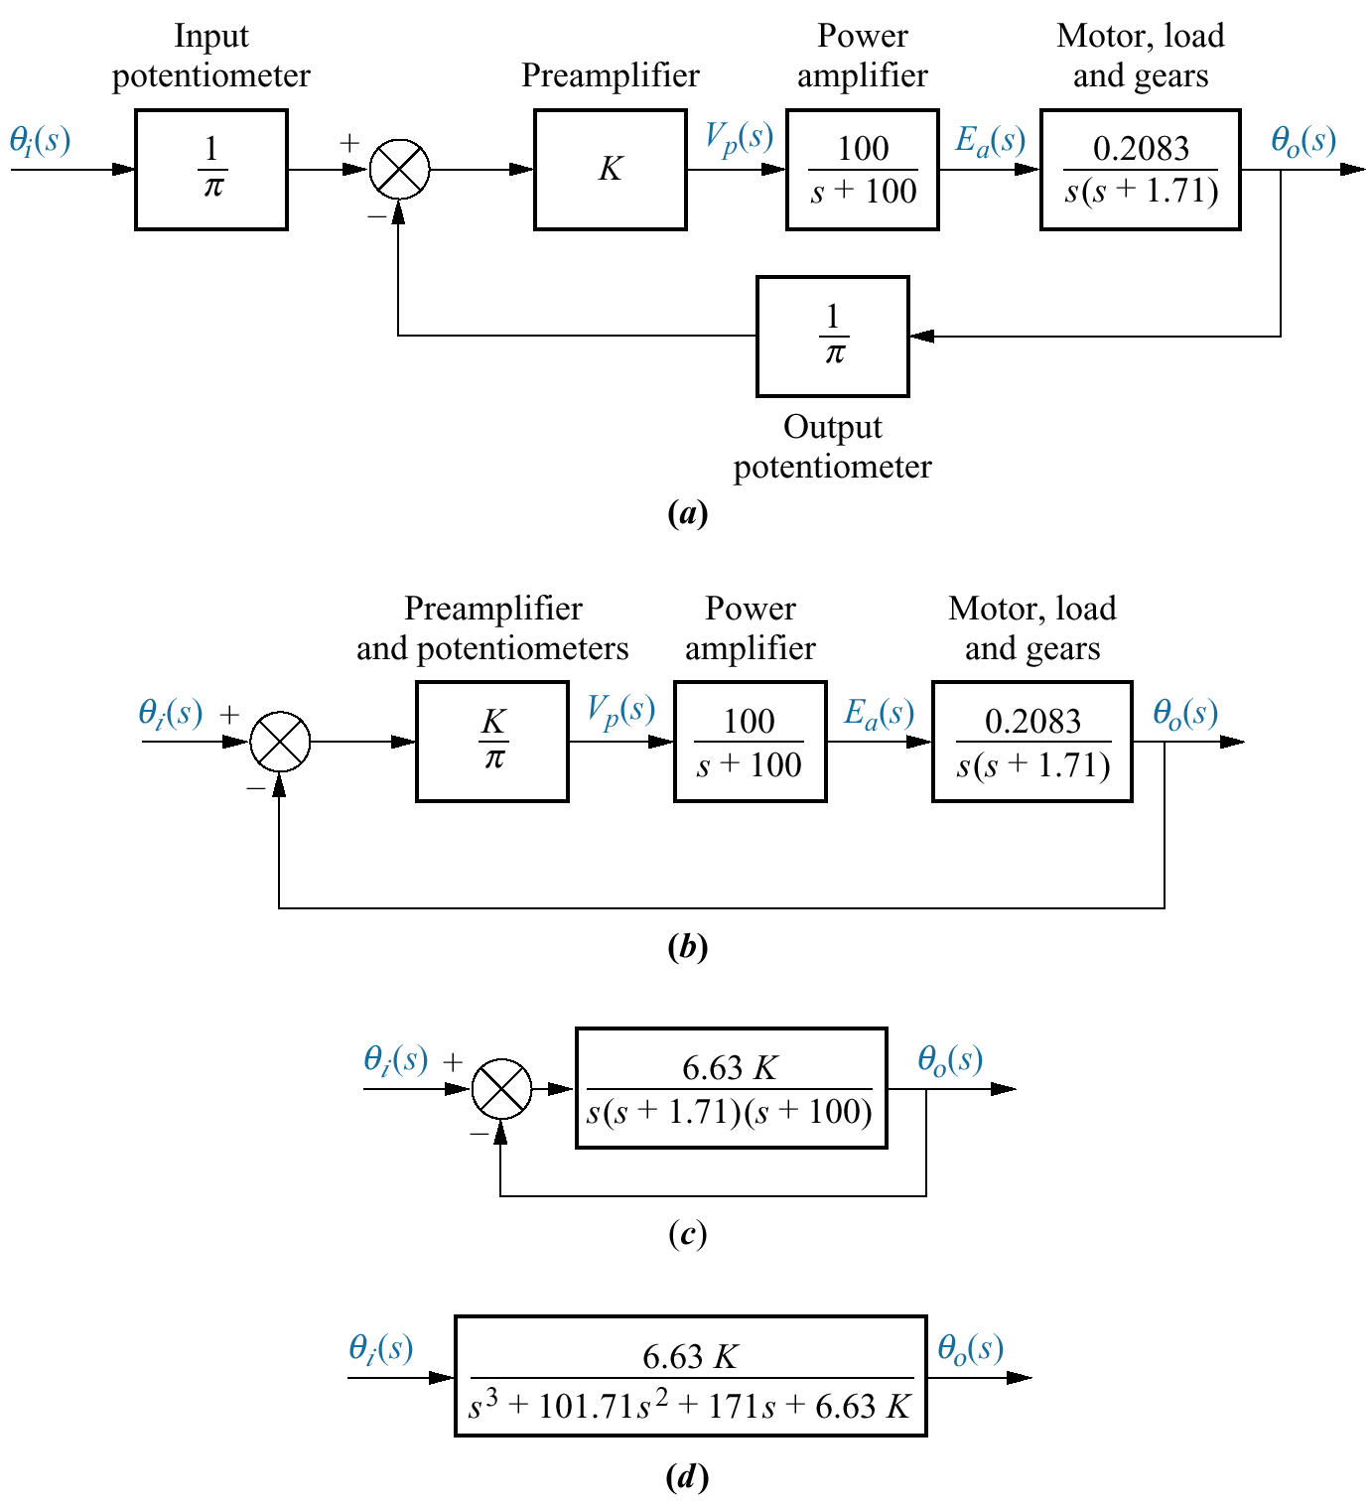
Figure 5.35
Block diagram
reduction for the
antenna azimuth
position control
system:
a. original;
b. pushing input
potentiometer to
the right past the
summing junction;
c. showing equivalent
forward transfer
function;
d. final closed-loop
transfer function

Slide 38
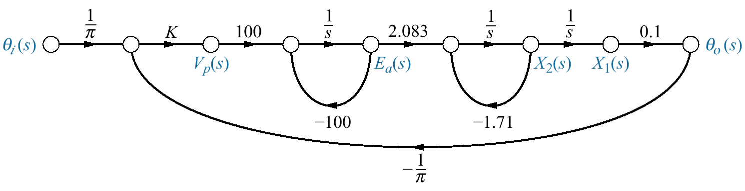
Figure 5.36
Signal-flow graph for
the antenna azimuth
position control
system

Slide 39
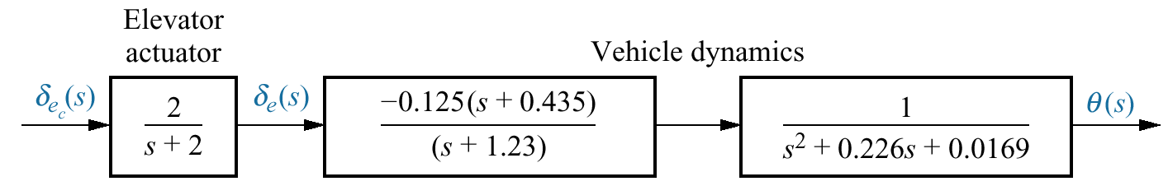
Figure 5.37
Block diagram of
the UFSS vehicle’s
elevator and vehicle
dynamics, from which
a signal-flow graph
can be drawn

Slide 40
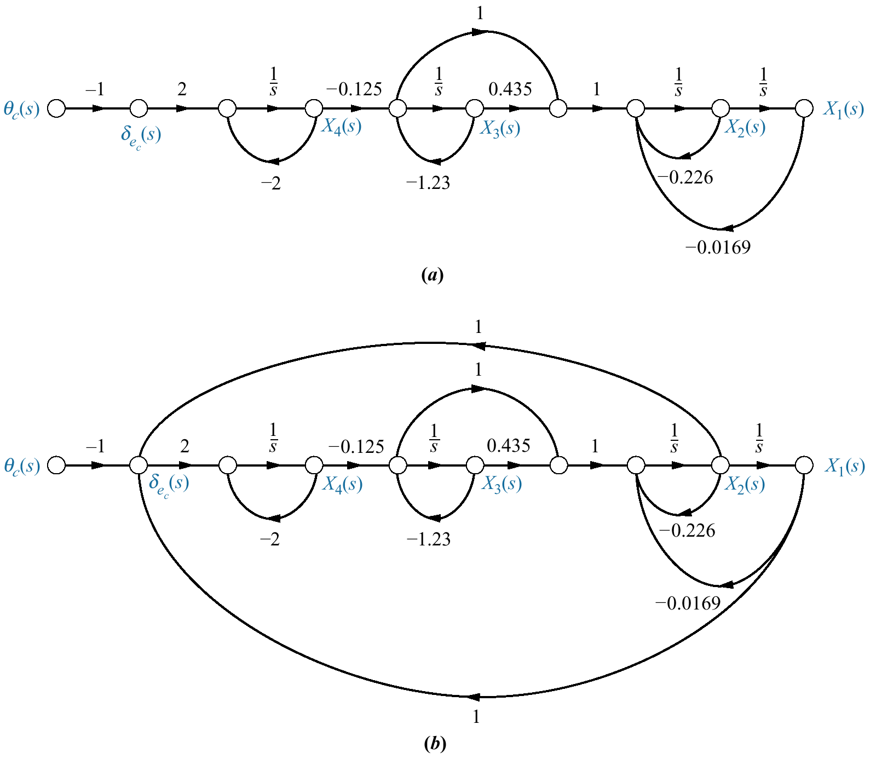
Figure 5.38
Signal-flow graph
representation of the
UFSS vehicle’s pitch-
control system:
a. without position and
rate feedback;
b. with position and
rate feedback
(Note: Explicitly
required variables are:
x₁ = θ, x₂ = dθ/dt,
and x₄ =δ_{e})

Slide 41
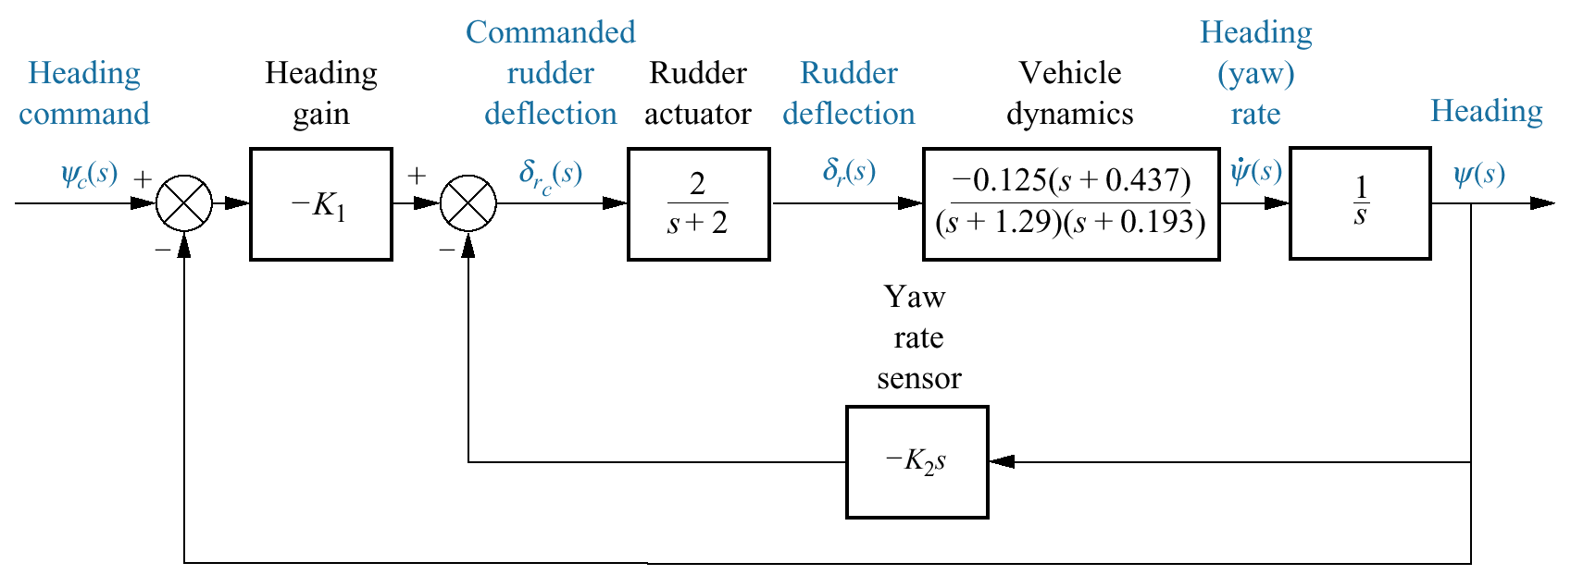
Figure 5.39
Block diagram
of the heading
control system
for the UFSS
vehicle

Slide 42
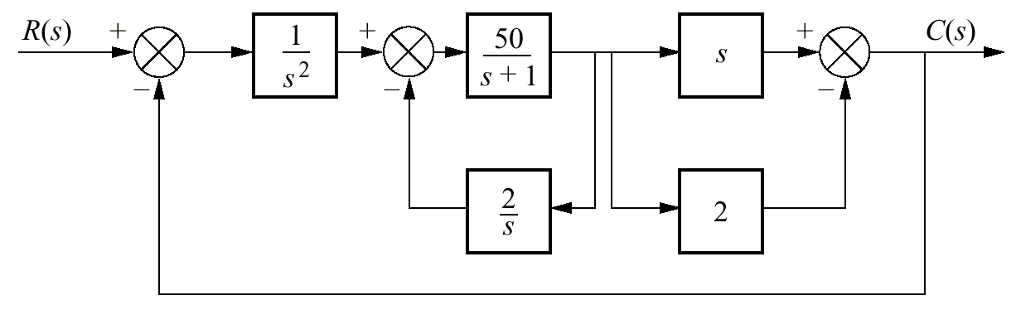
Figure P5.1

Slide 43
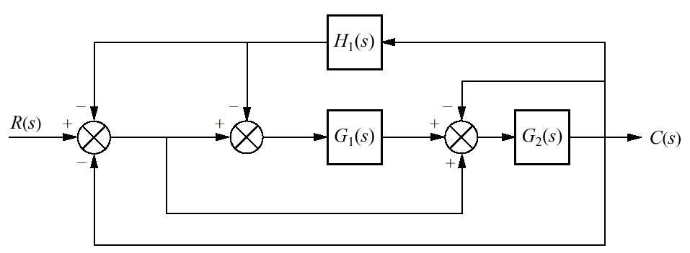
Figure P5.2

Slide 44
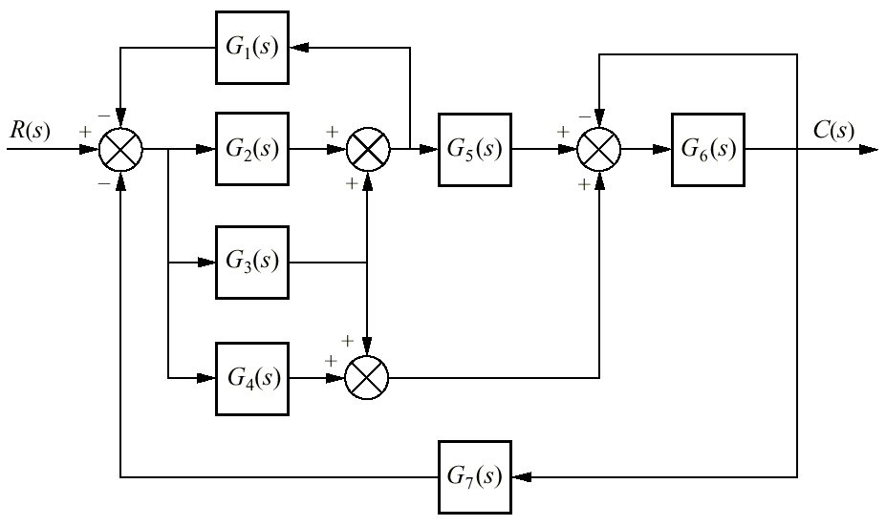
Figure P5.3

Slide 45
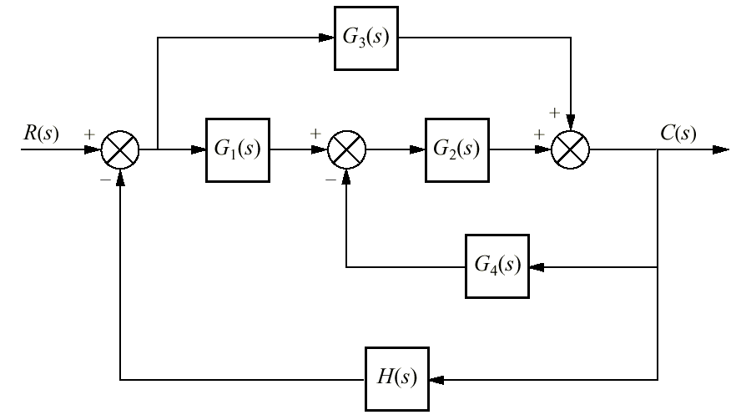
Figure P5.4

Slide 46
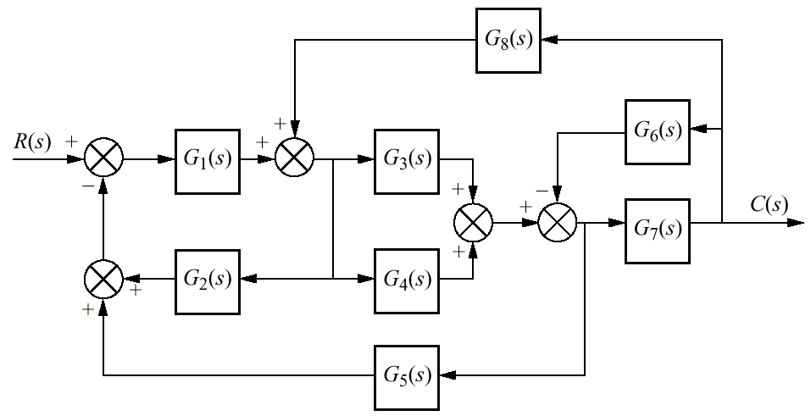
Figure P5.5

Slide 47
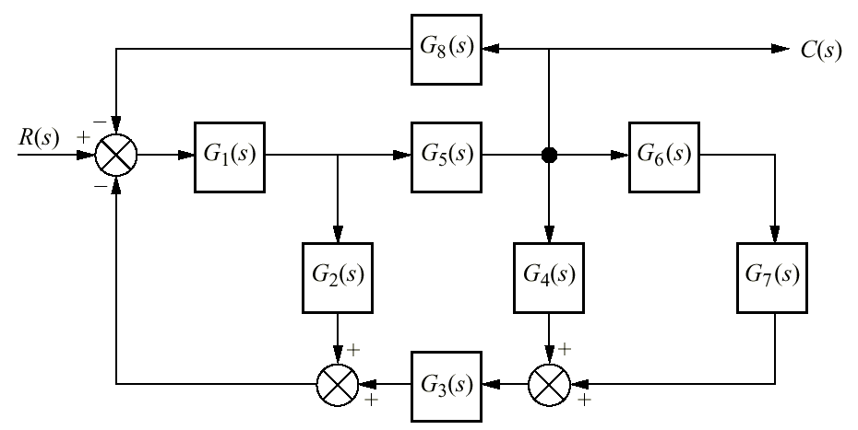
Figure P5.6

Slide 48
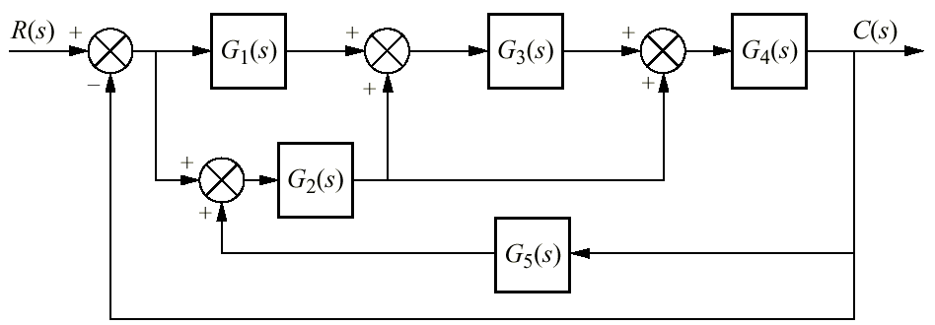
Figure P5.7

Slide 49
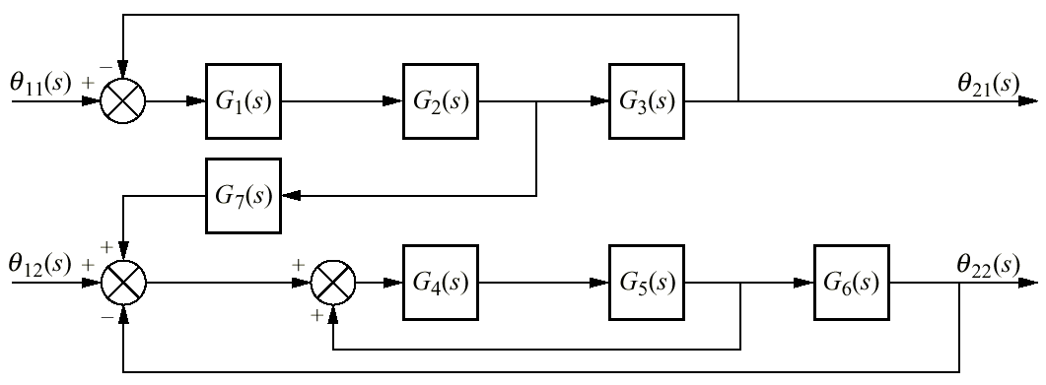
Figure P5.8

Slide 50
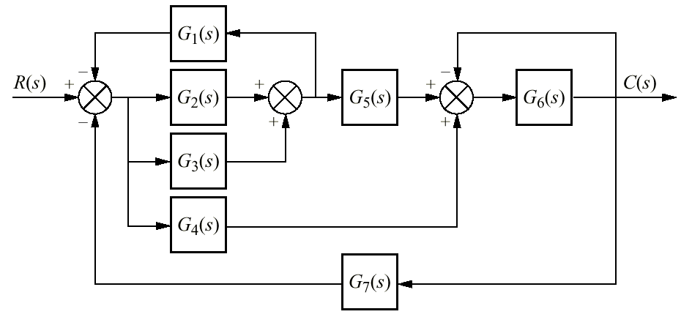
Figure P5.9

Slide 51
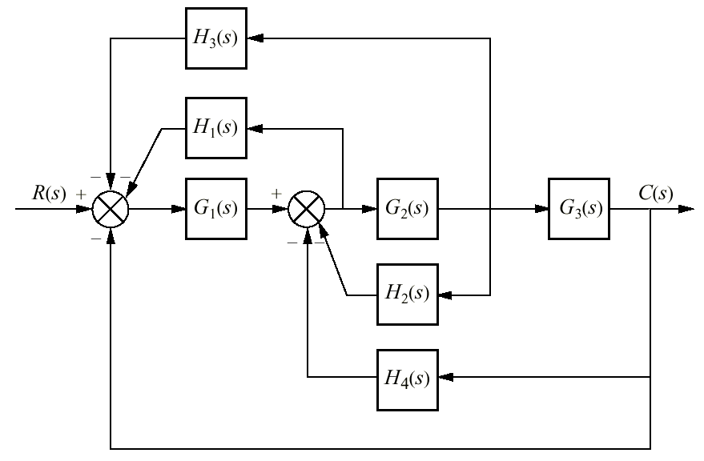
Figure P5.10

Slide 52

Figure P5.11

Slide 53

Figure P5.12

Slide 54

Figure P5.13

Slide 55

Figure P5.14

Slide 56

Figure P5.15

Slide 57

Figure P5.16

Slide 58

Figure P5.17

Slide 59

Figure P5.18

Slide 60

Figure P5.19

Slide 61

Figure P5.20

Slide 62

Figure P5.21

Slide 63

Figure P5.22

Slide 64

Figure P5.23

Slide 65

Figure P5.24
(figure continues)

Slide 66

Figure P5.24
(continued)

Slide 67

Figure P5.25

Slide 68

Figure P5.26

Slide 69

Figure P5.27

Slide 70

Figure P5.28

Slide 71

Figure P5.29

Slide 72

Figure P5.30

Slide 73

Figure P5.31

Slide 74

Figure P5.32
Space shuttle pitch
control system
(simplified)

Slide 75

Figure P5.33
AM modulator

Slide 76

Figure P5.34
Feedback control
system representing
human eye movement

Slide 77

Figure P5.35
a. HelpMate robot
used for in-hospital
deliveries;
b. simplified block
diagram for bearing
angle control

Slide 78

Figure P5.36
a. Load tester
(© 1992 IEEE)
b. approximate
block diagram

Slide 79

Figure P5.37
Solenoid coil circuit

Slide 80

Figure P5.38
a. Position control:
motor and load;
b. block diagram

Slide 81

Figure P5.39
a. Position control;
b. position control
with tachometer

Slide 82

Figure P5.40
Position control

Slide 83

Figure P5.41
a. Motor and load;
b. Motor and load in
feedback system

